Slide 1

Articles reviews

Slide 2
Data-driven detection of counterpressing in professional football - Goal
Identify counterpressing and derive metrics that support coaches with the analysis of transitionsituations.
Additionally, infer objective influence factors for its success and assess the validity of peer-created rules of thumb established in by practitioners.

Slide 3
Data-driven detection of counterpressing in professional football - Methodologies
Counterpressing detection:
Manual counterpressing tagging procedure.
Around 20 features used.
XGBoost model for classification.
SHAP values to evaluate features.
Success metric:
Extracted: shots, expected goals and actual goals.
Succesful actions: ball is regained within five seconds and shot occurs within next 20 seconds.

Slide 4
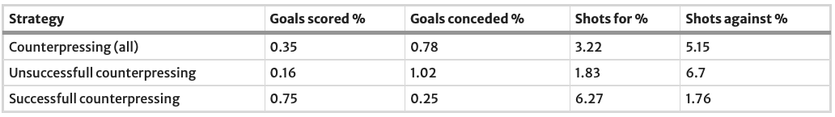
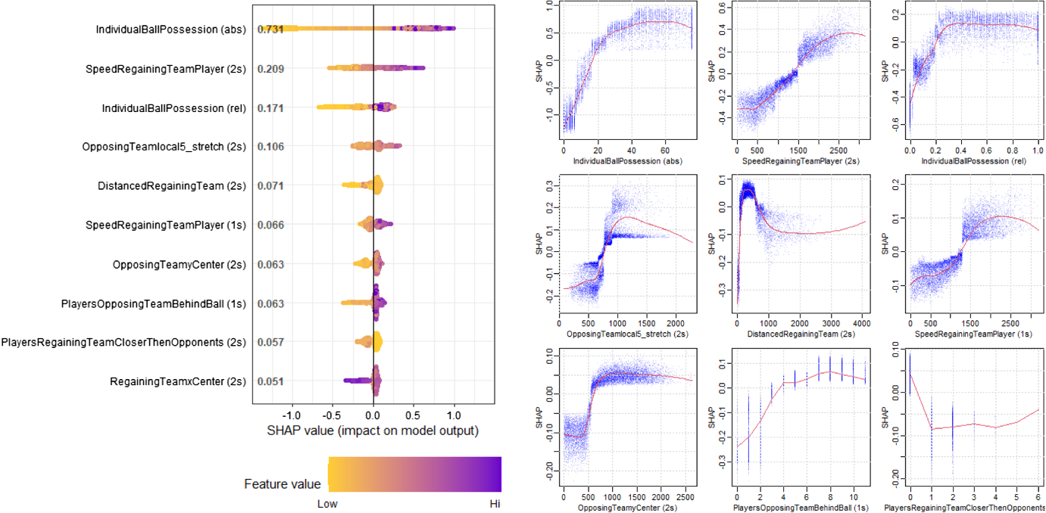
Data-driven detection of counterpressing in professional football - Results

Slide 5
Data-driven detection of counterpressing in professional football - Improvements
Low inter-labeler reliability (82.1%) using labelling-support methods.
Consider using continuous features, or even the raw positional data of all players instead of features at discrete time points.
Comparing their risk-reward structure to counterpressing situations, could lead to crucial insights by evaluating a teams’ decision to counterpressing versus falling back objectively

Slide 6
Goal!! Event detection in sports video
Goal:
Goal detection in broadcast low quality football videos.
Data:
200 sequences of 2-3 seconds videos where extracted, depicting the event of interest under a large number of viewing conditions including camera location, ego-motion, drastic illumination changes, low quality encoding, motion artifacts and cluttering among others.

Slide 7
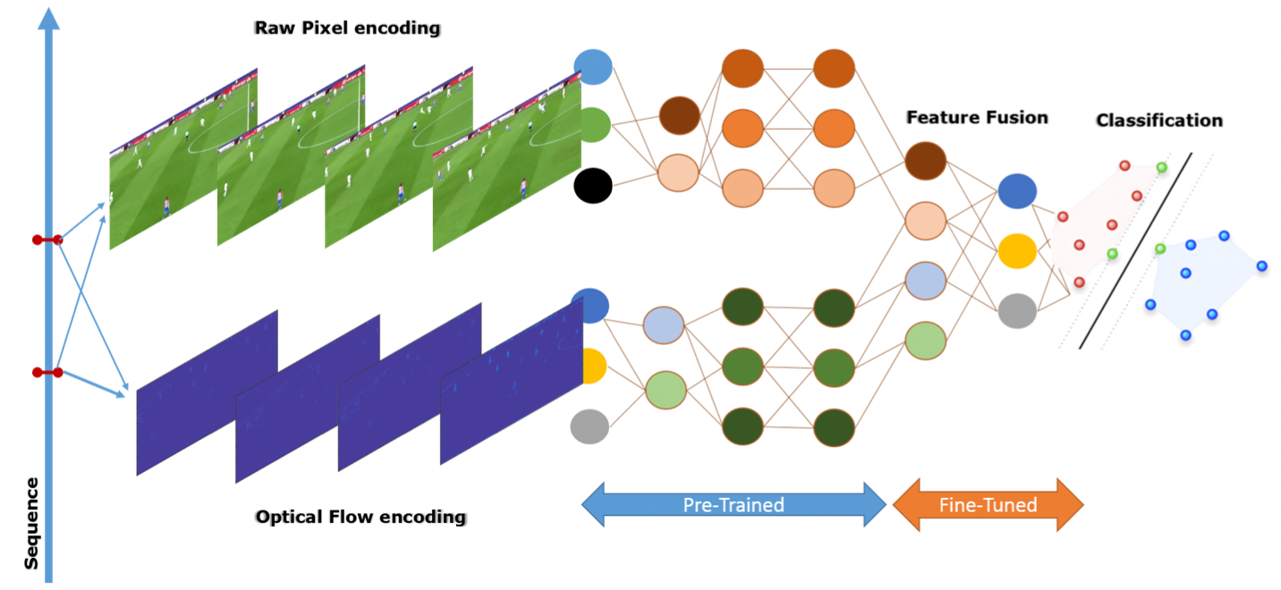
Goal!! Event detection in sports video - Methodologies
Two-stream CNN:
First stream: Spatial features extracted using VGG 16 Network
Second stream: Temporal features using VGG 16 Network & Optical Flow Encoding
Fusion: Sparsity regularized Autoencoder.
Classification: SVM

Slide 8
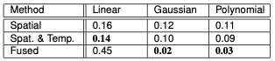
Goal!! Event detection in sports video- Results

Slide 9
Goal!! Event detection in sports video- Improvements
Using deep stacked encoders to improve classification process.
Use more advanced classification tool..
More advanced way to capture features than simple VGG 16 Network

Slide 10
Spotting Football Events Using Two-Stream Convolutional Neural Network and Dilated Recurrent Neural Network
Goal:
Spotting football events in long videos, which models the long-range and mid-range correlations between frames in addition to the local spatiotemporal features in the neighborhood of each frame.
Data:
Data contains 500 matches with a total number of 6,637 annotated events-videos.

Slide 11
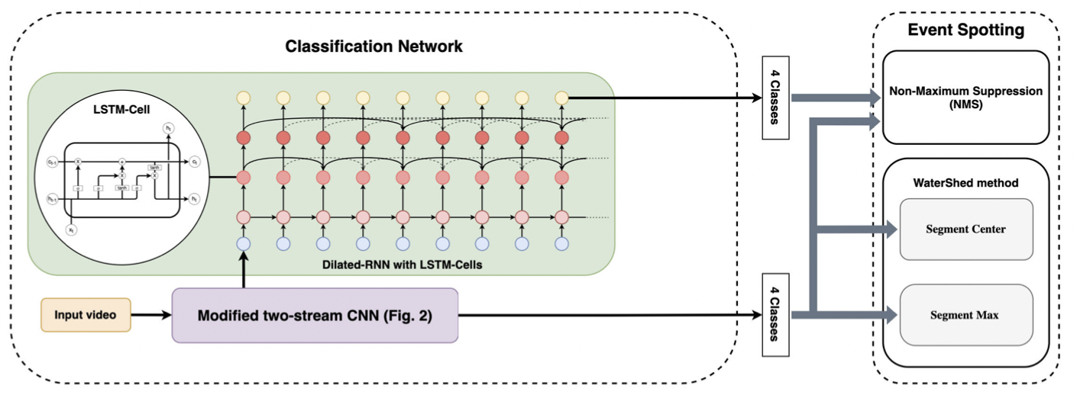
Architecture
Two stream CNN ResNet50 as a backbone.
DialatedRNN with LSTM units.
Three different algorithms for event spotting

Slide 12
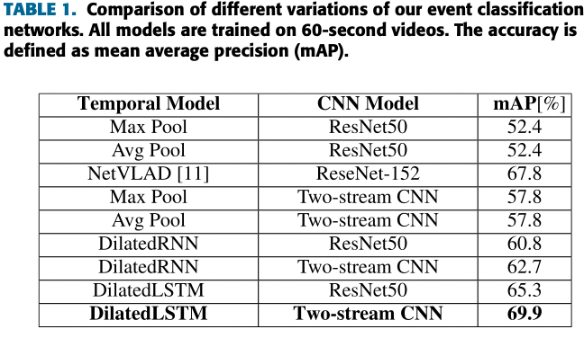
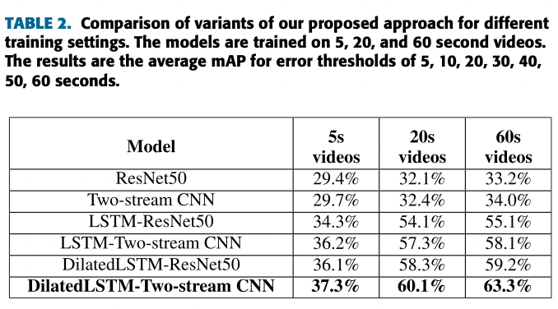
Results

Slide 13
Improvements
Maybe better way to provide spatial information. They are based on the videos I assume that this model doesn’t learn much about interactions between players in specific event which might be also crucial factor.

Slide 14
Making Offensive Play Predictable - Using a Graph Convolutional Network to Understand Defensive Performance in Soccer
Goal:
Model defensive behaviour and its effect on attacking behaviour. So it will be possible to evaluate defensive performance.
Data:
Positional data from wide range of games from top 5 europe leagues.

Slide 15
Methodology
Player Availability: Using the outputs from xReceiver and xPass we infer how available every attacker is off the ball at each frame.
Defensive Impact: We are able to detect high level defensive concepts such as ball and man orientated defending, defensive position play and off ball runs.
Disruption Maps: Global visual representations of defending teams’ ability to disrupt the oppositions attacking strategy.
Train 6 models using GNNs:
XReceiver: Probability for every player to become the pass receiver
xThreats: probability of a shot occurring within next 10 seconds if a pass was played to attacker.
xPass: Predicts how likely a pass would be completed to each attacker off the ball at any moment within a player possession.

Slide 16
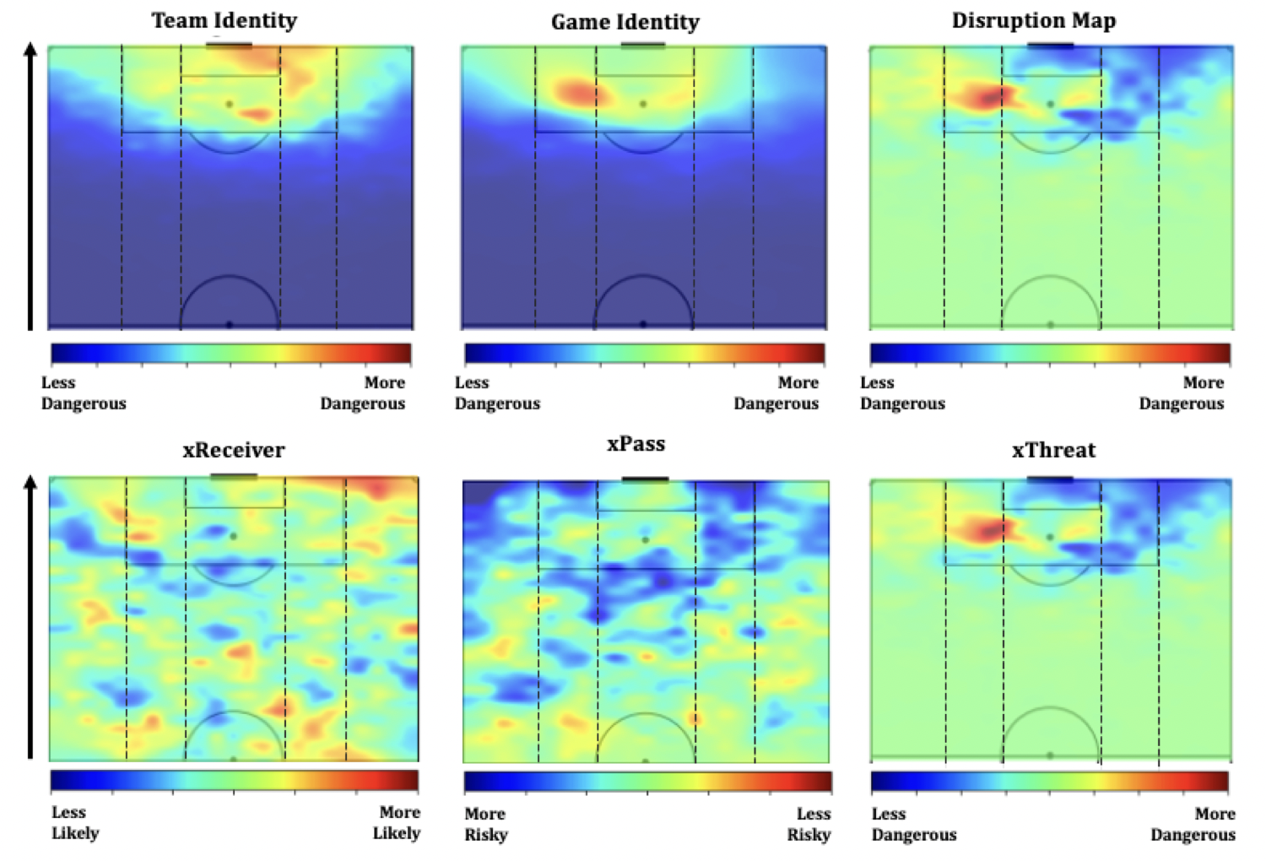
Results
xThreat and xPass models allows to value not just what did happen but what could have happened or more accurately what was prevented.
Disruption Maps is a weighted 2d distribution that shows where a team, positively or negatively, disrupted the oppositions off ball options.

Slide 17
Improvements
Identify different defensive styles (man and ball orientated defending) and off ball runs by active learning approach where labels are generated, trained against and then assessed.

Slide 18
Event Detection in Football using Graph Convolutional Networks
Goal:
Formulating the pipeline for generating a high-level view of the football field (referred to as a minimap) using ball-player bounding boxes and camera calibration
Describing how football tracking data can be modelled using graphs and then processed using Graph Convolutional Networks
Formulating event detection as an action spotting task, which involves localizing events to a certain timestamp in a video
Experimenting with different pooling methods for modelling the temporal context around each action

Slide 19
Methodology
Transforming videos to minimaps:
Merge videos into panorama by calibration.
Faster-RCCN with ResNet backbone used to detect players and ball.
Hungarian algorithm weas used to associate detections with trajectories based on extracted features, positioning the previous frame and estimation of their current position using Kalman filter.
Then positions are projected onto the pith minimap
Further steps:
Collecting graph features two for positions and 3 one-hot encodings
Plug them into GNNs
Pooling (AVG, MAX, NetVLAD, NetRVLAD)
Multi-label classifier

Slide 20
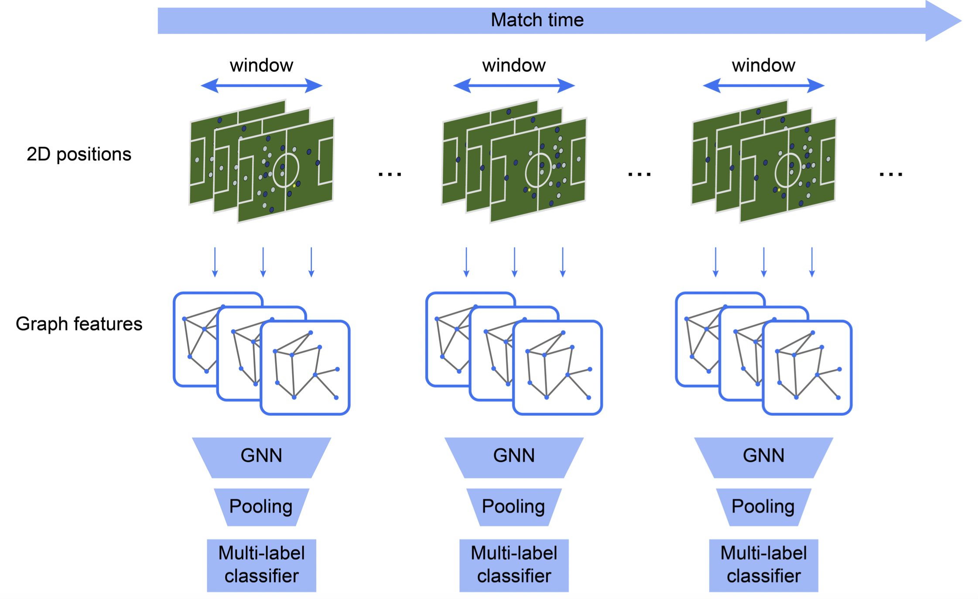

Slide 21
Results
Overcome problems with unclear order players in a sequence and to handle missing objects of the interest.
Show how the performance of pooling layers in event detection models can be improved by considering the context before and after the action separately.

Slide 22
Improvements
Introduce self-supervising tasks to pretrain graphs.
Predicting the future motion of teams given the previous positions of its players over the window.

Slide 23
Deep soccer analytics: learning an action-value function for evaluating soccer players
Goal:
Apply Deep Reinforcement Learning (DRL) to learn an action-value Q-function from events in a soccer game. Apply Deep Reinforcement Learning (DRL) to learn an action-value Q-function from events in a soccer game.

Slide 24
Methodology
Architecture:
Two tower design for home and away teams separately. Each tower captures the play history with a stacked LSTM
Home/Away Team Identifier to select the hidden state from home or away tower according who possess the ball.
Selected hidden state values are sent to hidden layers whose outputs are normalized by softmax.
Weight training:
Sarsa method and apply a dynamic possession LSTM to control the trace length during training.
Markov game model:
Two agents Home and Away
Action denotes movements of players who control the ball
Observation is a feature vector specifying a value of the features.
Reward is the goal value.
Goal Q-function:
Divide a soccer game into goal-scoring episodes.

Slide 25
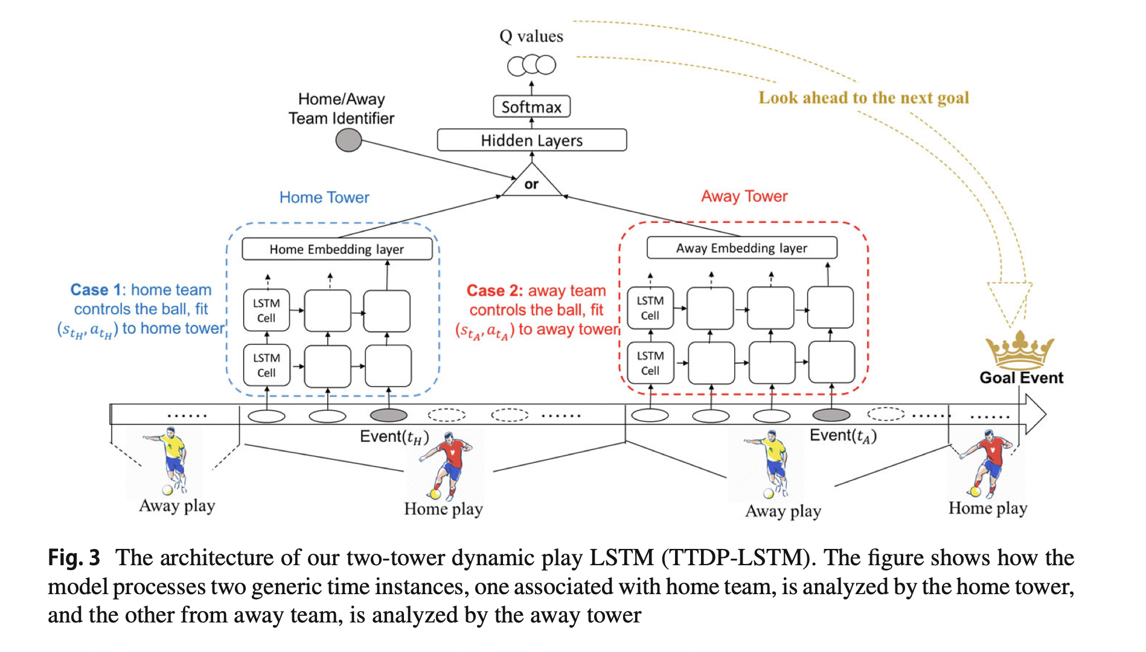

Slide 26
Results
Overcome problems with unclear order players in a sequence and to handle missing objects of the interest.
Show how the performance of pooling layers in event detection models can be improved by considering the context before and after the action separately.

Slide 27
Improvements
Incorporating tracking data
Developing on-line deep RL methods.

